Slide 1
Line Followers: Basic to Proportional
By Sanjay and Arvind Seshan

Slide 2
Lesson Objectives
Evaluate and compare different line followers
Learn to use the concept of “proportional” to create a proportional line follower
Prerequisites: Basic Line Follower, Color Line Follower, Color Sensor Calibration, Proportional Control, Math Blocks, Data Wires

Slide 3
Which Program Works Best for Which Situation?
Simple Line Follower
Most basic line follower
Wiggles a lot due to sharp turns
Good for rookie teams → need to know loops and switches
Smooth Line Follower
Almost the same as simple
Turns are less sharp
Has trouble on sharp curves
Good for rookie teams → need to know loops and switches
3-Stage Follower
Best for straight lines
Droids do not recommend this. Just learn the proportional line follower.
Need to know nested switches
Proportional Follower
Uses the “P” in PID
Makes proportional turns
Works well on both straight and curved lines
Good for intermediate to advanced teams → need to know math blocks and data wires
Watch the videos on the next 2 slides to see all four.

Slide 4
Curved Line: Watch Videos
Simple Line Follower
Smooth Line Follower
3-Stage Follower
Proportional Follower

Slide 5
Straight Line: Watch Videos
Simple Line Follower
Smooth Line Follower
3-Stage Follower
Proportional Follower

Slide 6
3 Line Follower Challenges
Challenge 1: Can you write a simple line follower? Hint: Review Beginner: Basic Line Follower lesson
Challenge 2: Can you write a smoother line follower? Hint: Change how sharp the turns are in a simple line follower.
Challenge 3: Can you write a three-stage line follower where the robot moves different 3 different ways (left, right or straight) based on the reading from the color sensor?

Slide 7
A Note About Our Solutions
CALIBRATE:
The programs use the EV3 Color Sensor in Light Sensor mode
You will have to calibrate your sensors.
Please refer to Intermediate: Color Sensor Calibration Lesson
PORTS:
The Color Sensor is connected to Port 3.
Please change this for your robot.
WHICH SIDE OF THE LINE:
Please take note of which side of the line the code is written for

Slide 8
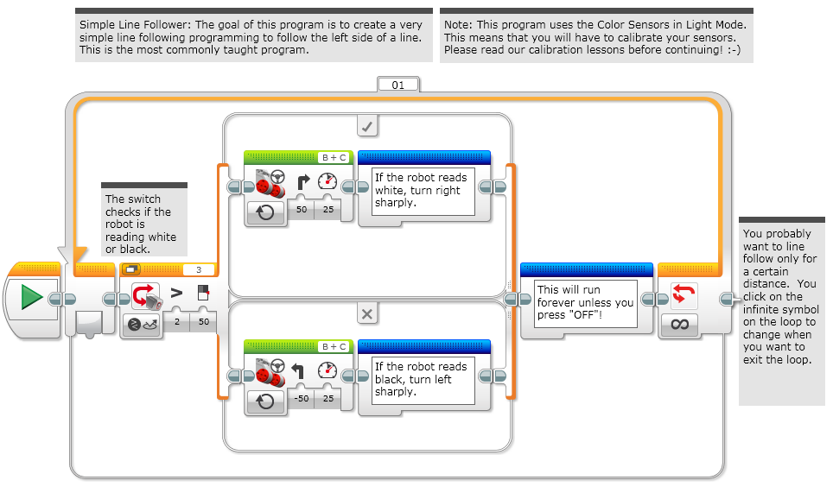
Solution 1: Simple Line Follower

Slide 9
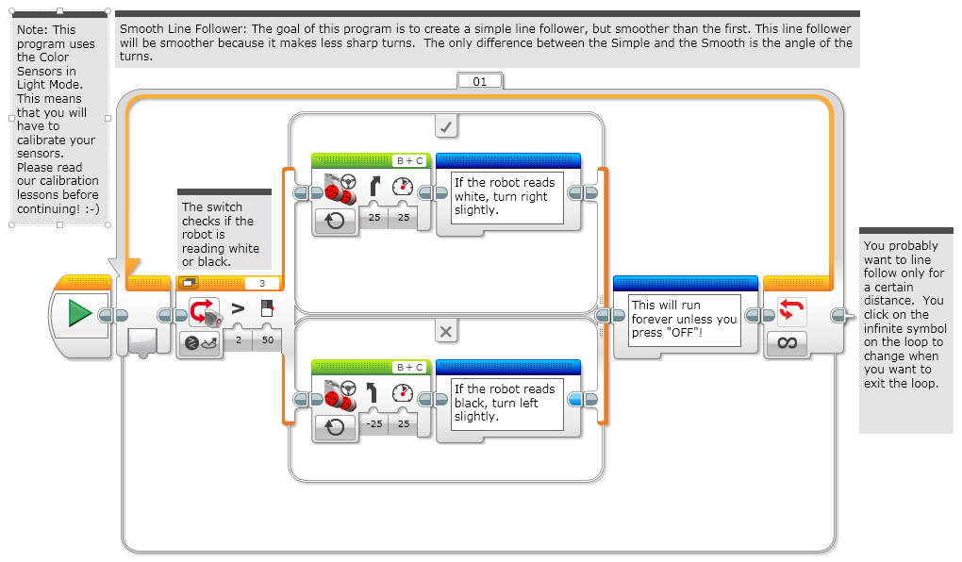
Solution 2: Smooth Line Follower

Slide 10
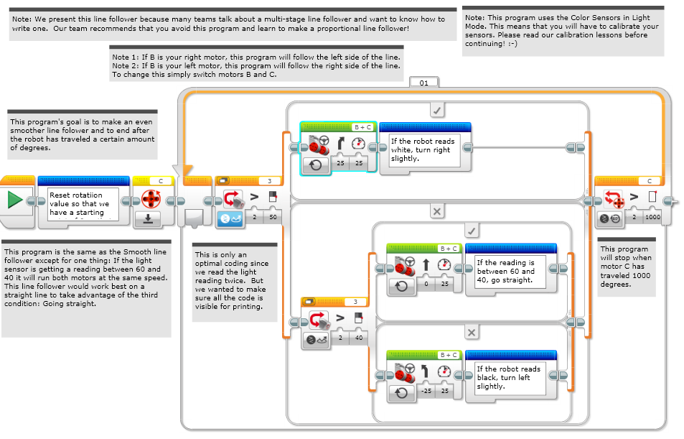
Solution 3: Three-Stage Line Follower

Slide 11
Challenge 4: Proportional Line Follower
Challenge 4: Can you write a proportional line follower that changes the angle of the turn depending on how far away from the line the robot is?
Pseudocode:
Reset the Rotation sensor (Only required for line following for a total distance)
Compute the error = Distance from line = (Light sensor reading – Target Reading)
Scale the error to determine a correction amount. Adjust your scaling factor to make you robot follow the line more smoothly.
Use the Correction value (computer in Step 3) to adjust the robot’s turn towards the line.

Slide 12
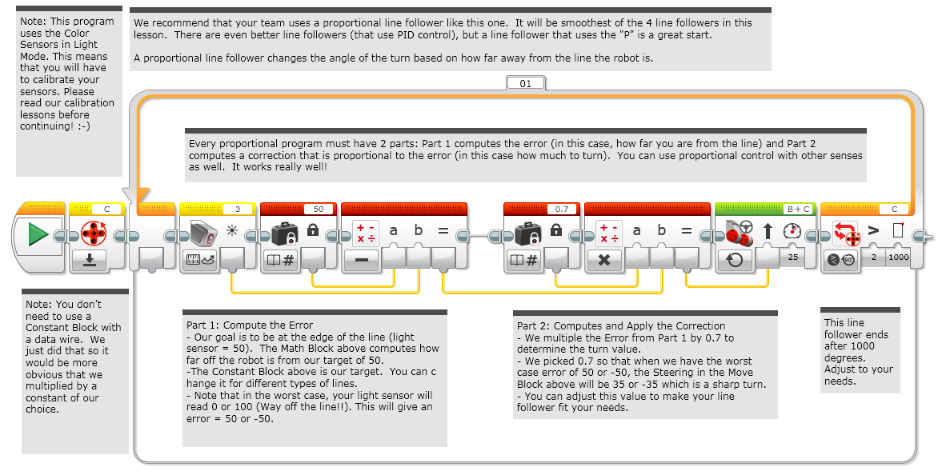
Solution: Proportional Line Follower

Slide 13
Tips
You will get better results
….if your color sensors are closer to the ground
….remember to calibrate

Slide 14
Discussion Guide
Simple Line Follower
+
+
-
-
Smooth Line Follower
+
+
-
-
Three-Stage Line Follower
+
+
-
-
Proportional Follower
+
+
-
-
Fill in the above with positives and negatives of each technique. Consider if the line follower is best for curved or straight lines. Consider if the robot will wiggle a lot.

Slide 15
Credits
This tutorial was created by Sanjay Seshan and Arvind Seshan
More lessons at www.ev3lessons.com
This work is licensed under a Creative Commons Attribution-NonCommercial-ShareAlike 4.0 International License.

